Slide 1
Leveraging scalable Python-based geoscience tools to analyze land surface climate in the Arctic
Diana R. Gergel
Ph.D. Candidate and Research Assistant
Computational Hydrology group, University of Washington
January 17th, 2019

Slide 2
Outline
Introduction to climate modeling
the Regional Arctic System Model (RASM)
High performance computing (HPC) and climate modeling
Scalable geoscience tools
Demo of geoscience tools

Slide 3
#Arctic sea ice takes Facebook's #HowDidAgeHitYouChallenge
NASA images based on National Snow and Ice Data Center (Boulder, CO) data at bit.ly/2Md4FfU

Slide 4
CO₂ and the Keeling Curve

Slide 5
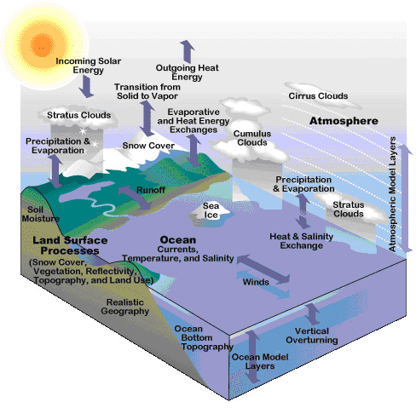
What’s in a climate model?
UCAR
Notes:
Past climate (paleoclimate modeling)
Historical climate change
Future climate under increased CO₂ emissions

Slide 6
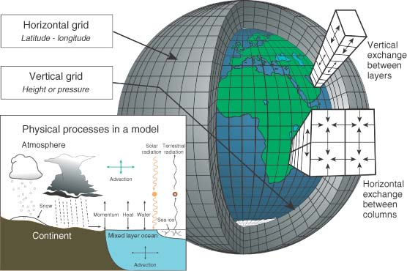
Climate Model Structure
Edwards 2010

Slide 7
Types of climate models
Global Climate Models (GCMs)
Regional Climate Models (RCMs)

Slide 8
Higher resolution → more CPUs
Source: Mark Chandler, EdGCM, Carleton College

Slide 9
#Arctic sea ice takes Facebook's #HowDidAgeHitYouChallenge
NASA images based on National Snow and Ice Data Center (Boulder, CO) data at bit.ly/2Md4FfU

Slide 10
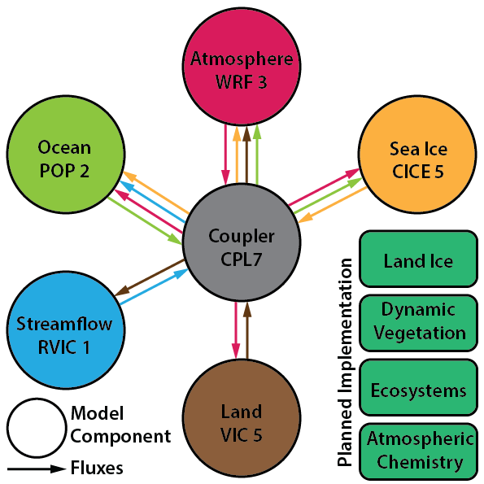
Introduction to the Regional Arctic System Model (RASM)
Fully-coupled, regional earth system model
Resolution:
50-km land/atmosphere
9-km ice/ocean
Higher-resolution simulations currently being scientifically validated
Atmospheric boundary conditions: Reanalysis data (e.g. MERRA, ERA-Interim, CFSR), CMIP5

Slide 11
RASM Domain
Carmack et al 2015

Slide 12
VIC 5 Development
VIC 4.0.4 → VIC 5
Frozen soils
Lakes/wetlands/blowing snow
Improved canopy/atmosphere interactions
Carbon cycle
Time vegetation parameters
Infrastructure:
Improved interface for coupling
Multiple drivers
Parallelization
Hamman JJ, B. Nijssen, T.J. Bohn, D.R. Gergel, Y Mao (2018) The Variable Infiltration
Capacity model version 5 (VIC-5): infrastructure improvements for new applications and Reproducibility. Geoscientific Model Development, 11, 3481–3496
doi: 10.5194/gmd-11-3481-2018

Slide 13
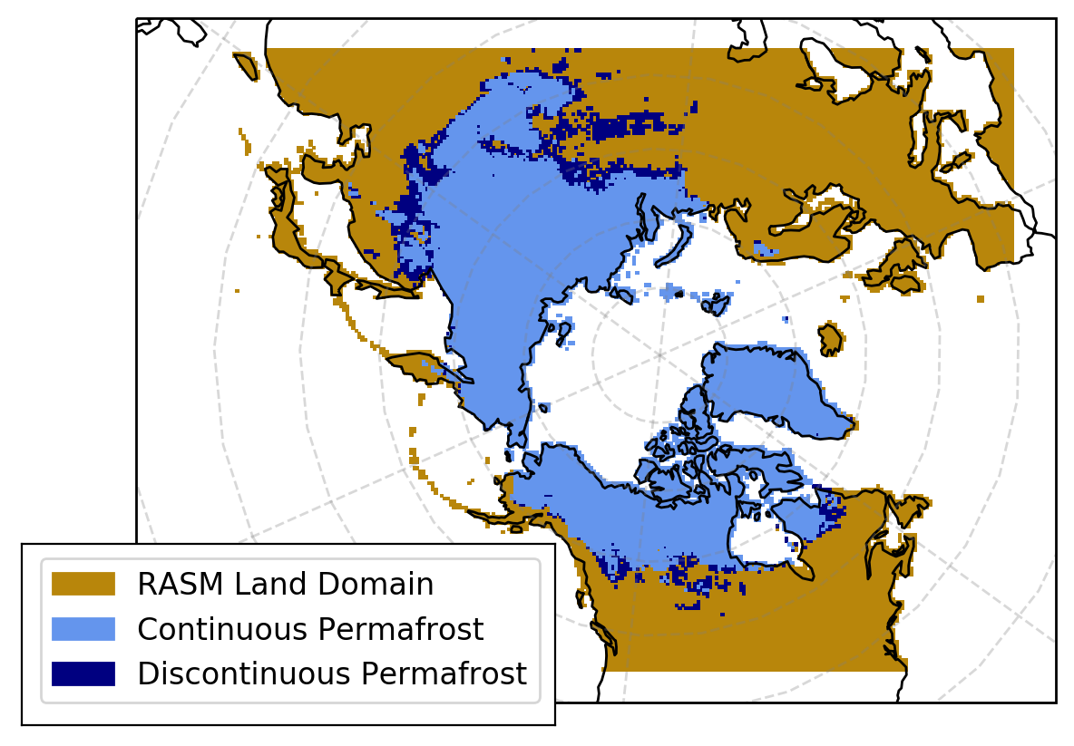
Permafrost Extent
Permafrost extent calculated using soil temperature method as in Slater and Lawrence (2013), at a model depth of 3.1 m below the surface across the domain
Continuous permafrost covers much of the RASM domain, with discontinuous permafrost comprising a much smaller proportion
Other parts of the RASM domain (marked as RASM Land Domain) experience sporadic/isolated permafrost
Notes:
Extent of permafrost underscores the significance of permafrost degradation to the coupled climate system

Slide 14
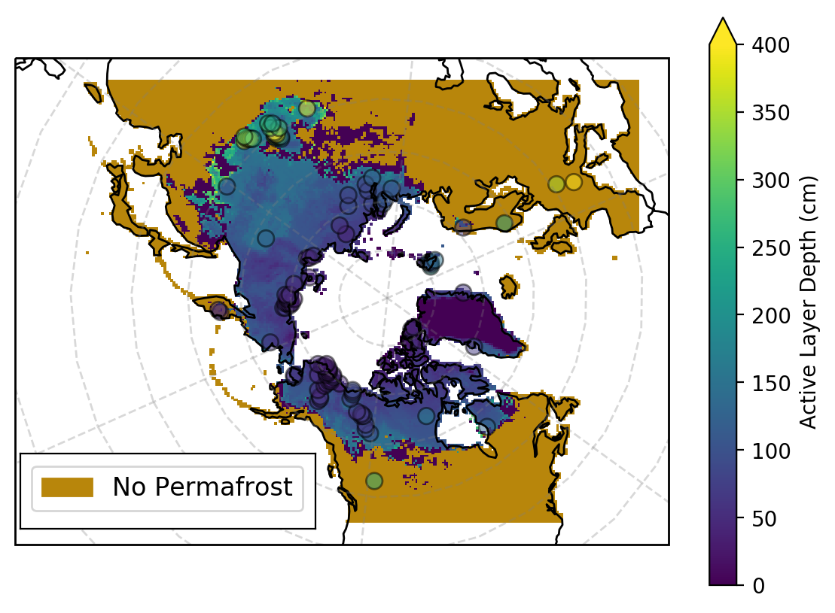
Active Layer Depth
ALT computed by fitting a soil thermal profile for each grid cell using spline interpolation of mean August temperatures and finding the temperature at which the profile crossed the 0ºC isotherm
Comparing modeled to observed ALT shows better agreement in colder parts of the domain

Slide 15

Climate Modeling and High Performance Computing

Slide 16
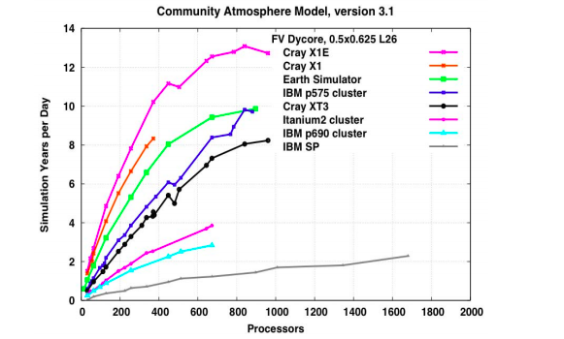
Source: LLNL site, https://computation.llnl.gov/casc/projects/2007/climate_2007F.pdf
Notes:
Figure 2. Performance of Community Atmosphere Model at 0.5x0.625-deg resolution on leading massively parallel architectures. On a per-processor basis, the Cray X1E provides the fastest throughput.

Slide 17
RASM Supercomputing Resources
Air Force Research Laboratory (AFRL)
Mustang
Thunder
Engineer Research and Development Center (ERDC)
Topaz
Onyx

Slide 18
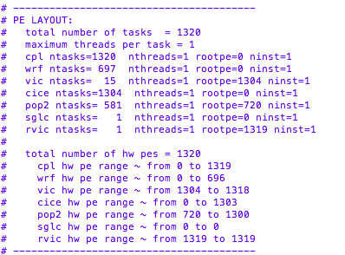
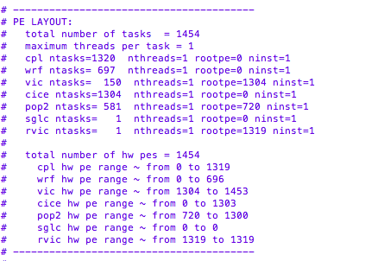
RASM: processor layouts

Slide 19
Scalable geoscience tools
Xarray
Dask
Pandas
Cartopy
JupyterLab
All under umbrella of PANGEO: a community platform for big data geoscience

Slide 20
Pangeo: a community platform for big data geoscience
Image courtesy of: https://pangeo.io/

Slide 21
Pangeo stack
Image courtesy of: https://pangeo.io/
For more info on Pangeo: https://pangeo.io/

Slide 22
Pangeo stack
Image courtesy of: https://pangeo.io/
For more info on Pangeo: https://pangeo.io/

Slide 23
Questions before we move into demos?
E-mail: gergel@uw.edu
GitHub: dgergel

Slide 24
Example notebook, virtual environment and sample data are posted in a GitHub repo created for this event: scientific_computing_20190117
https://github.com/dgergel/scientific_computing_20190117

Slide 25
Demo 1: Low Warming Ensemble

Slide 26
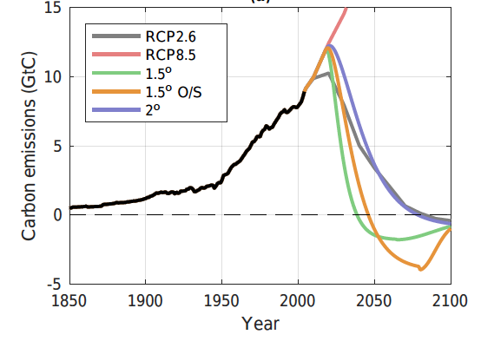
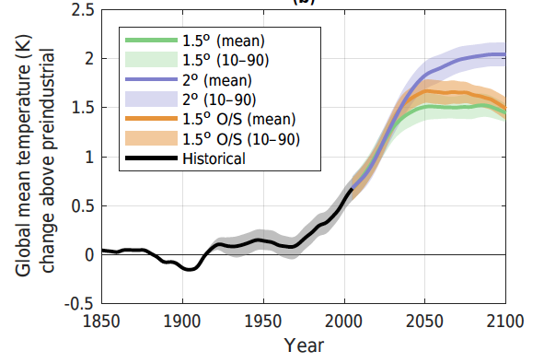
Low Warming Ensemble
Set of climate simulations that represent the warming levels laid out by the December 2015 Paris Agreement to keep global temperatures below 1.5°C above preindustrial levels and well below 2°C
MiCES model used to produce scenarios to achieve long-term 1.5°C and 2°C temperatures in a stable climate (Sanderson et al 2016)
Scenarios used to produce century-scale ensemble simulations using the Community Earth System Model (CESM) GCM, branching from the CESM Large Ensemble in 2005
Sanderson et al 2017

Slide 27
Demo 2: Land Surface Parameters

Slide 28
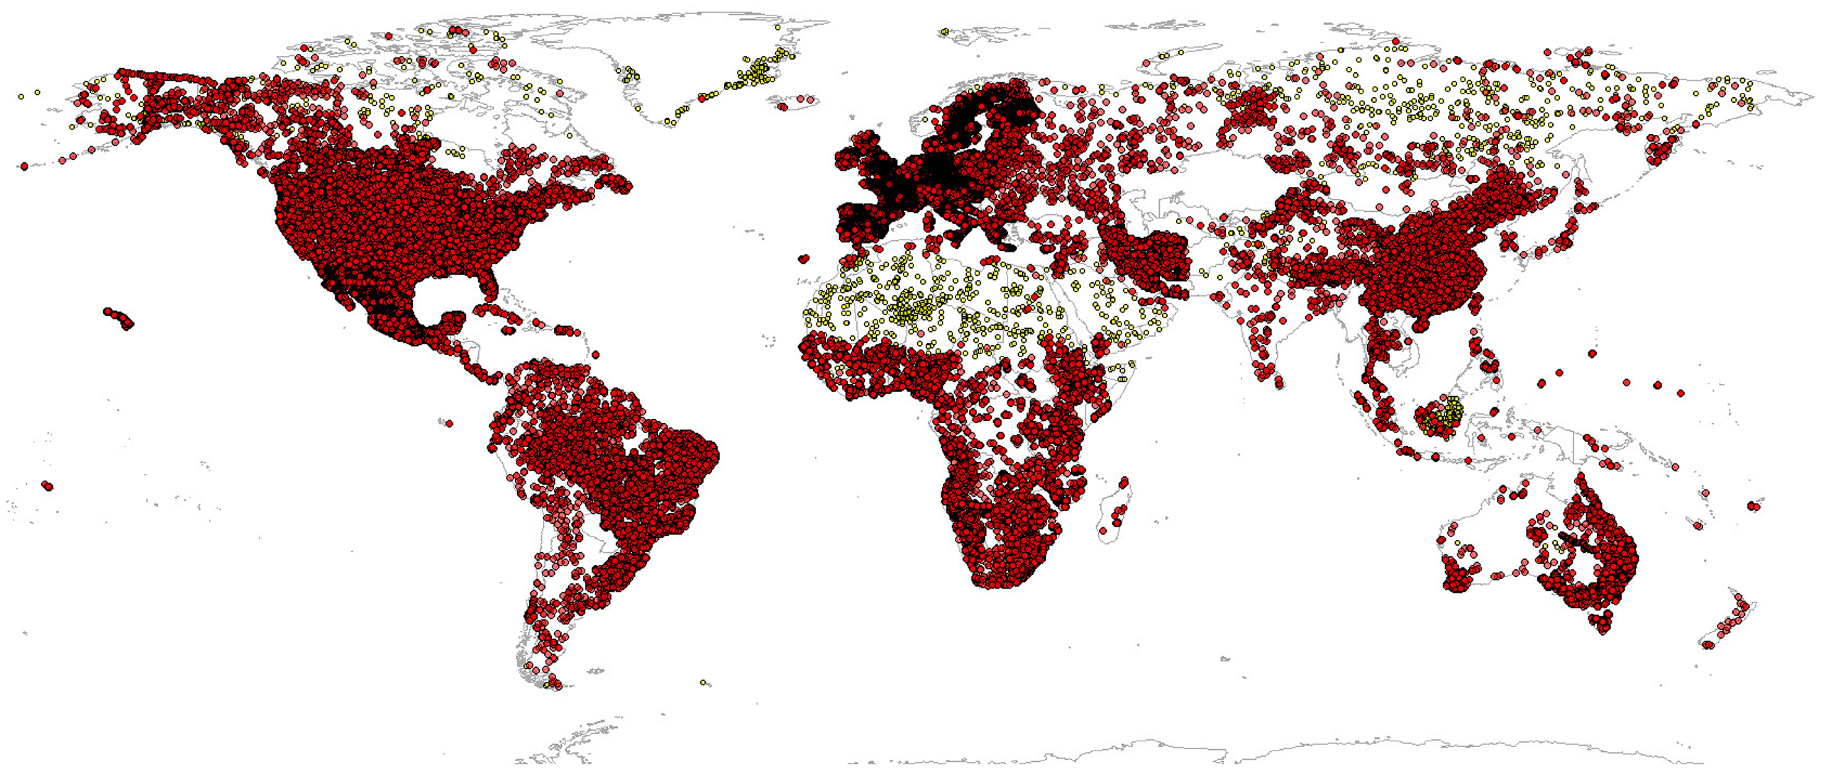
VIC-5 Parameter Data Needs and Source Datasets
Soil data
Soil texture and Organic content
ISRIC Global 1-km soil dataset
(machine learning-based)
Vegetation classes
Plant Functional Types (PFTs)
CLM 4.5 0.05-deg dataset
Leaf Area Index (LAI)
MODIS global LAI
Albedo
0.05-deg maximum albedo dataset,
Barlage et al. 2005)
Elevation
GTOPO30 DEM
Climatological temperature
and precipitation
WorldClim global data,
0.083-deg resolution
Global distribution of soil profiles used for model fitting in ISRIC dataset
From Hengl et al 2017

Slide 29
VIC-5 Parameters: Methods
Derived at 50km, 25km, and 12km resolutions
Derivation process is:
resolution agnostic (parameters can be made at any realistic resolution,
e.g. > 6 km, the coarsest resolution of the base datasets)
domain agnostic (parameters can be derived for any geographic domain globally
requires CF-compliant NetCDF domain file
Notes:
Resolutions: 50km, 25km and
12km
Derivation process is:
resolution agnostic (parameters can
be made at any realistic resolution,
e.g. > 6km, the coarsest resolution
of the base datasets)
domain agnostic (parameters can be
derived for any geographic domain
globally
requires CF-compliant NetCDF
domain file

